Slide 1
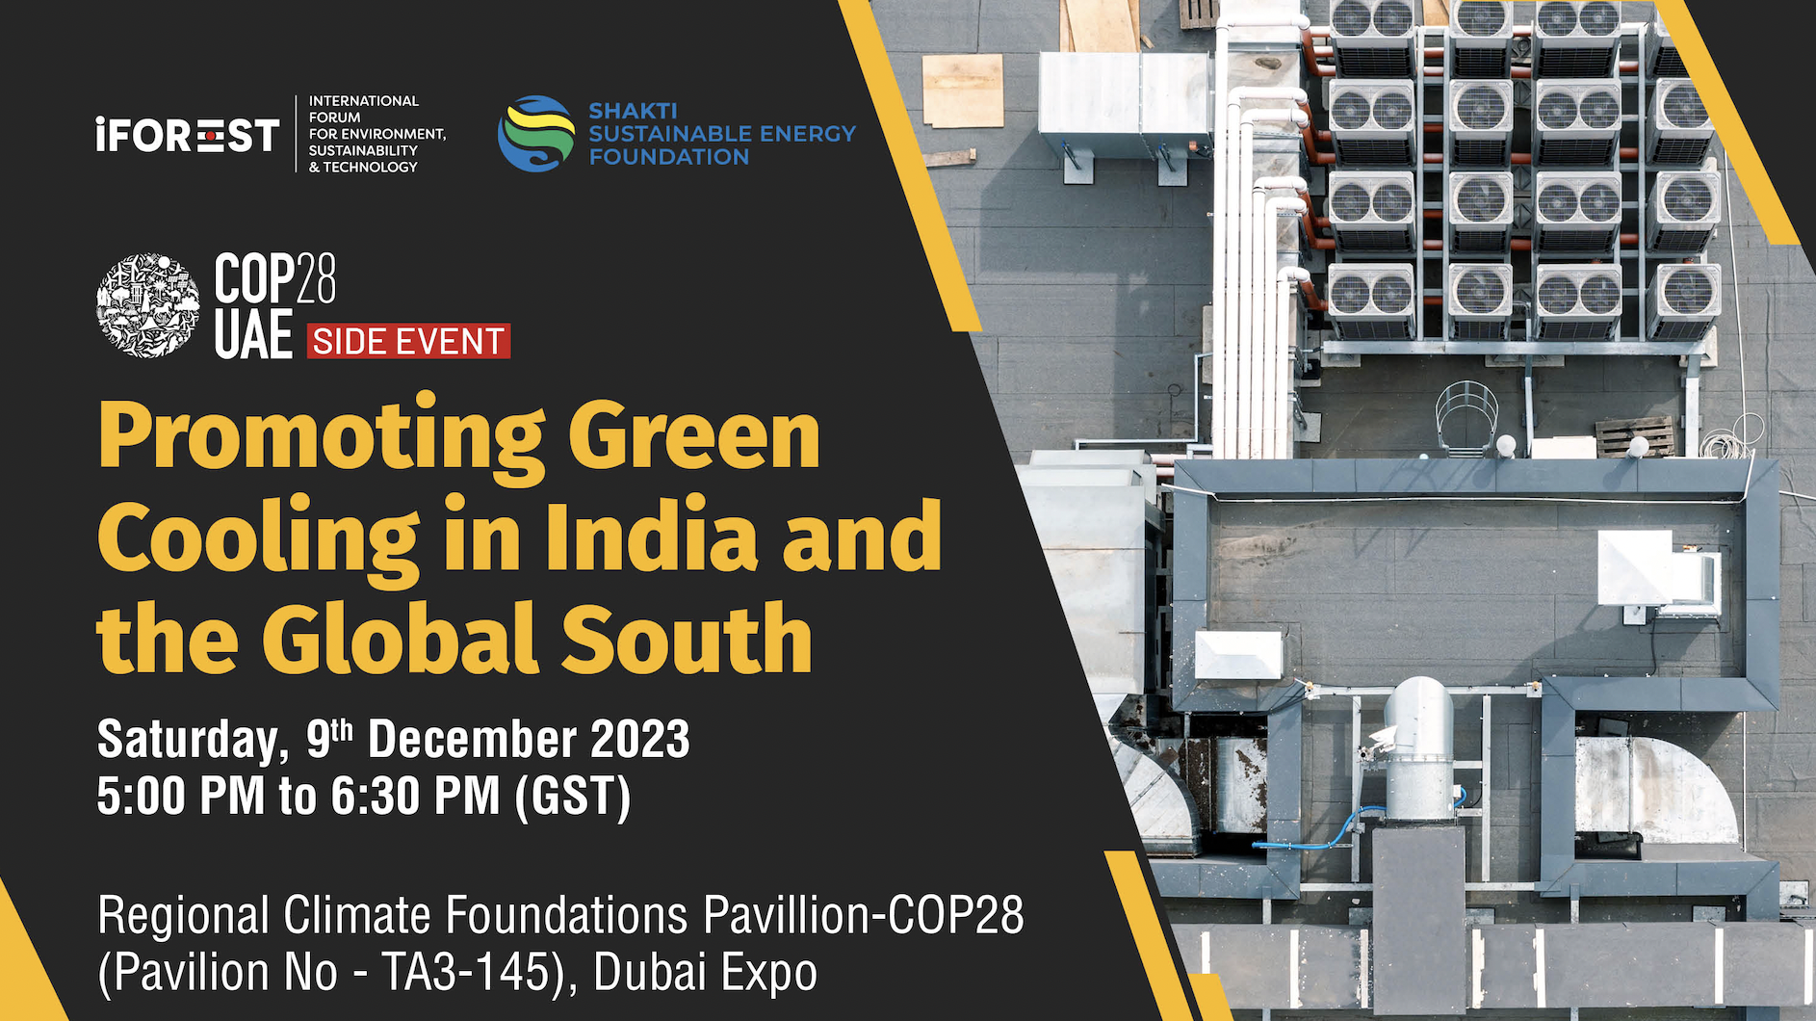


Slide 2
Promoting Green Cooling in India and the Global South
Thomas Spencer, IEA
Notes:
Hello, My name is Melanie Slade and I lead the IEA’s work on Energy Efficiency in Emerging Economies
I would firstly like to thank UNEP for the invitation to this important session to discuss Minimum Energy Performance Standards, which are a powerful policy tool for driving market transformation towards more efficient equipment and appliances.
It is also great to be able to contribute to furthering this conversation in the context of the Kigali Amendment to the Montreal Protocol, which is of course an influential platform for addressing energy efficiency in the cooling sector.

Slide 3
Space cooling demand booms, but efficiency can slow it down
Space cooling demand in advanced economies
and emerging market and developing economies, STEPS and APS, 2022-2050
TWh
3 000
2 500
2 000
1 500
1 000
500
2022
2025
2030
2035
2040
Space cooling demand is set to be the most significant driver of electricity demand growth, particularly in emerging market and developing economies; but strongly policies can reduce demand by 20% by 2040

Slide 4
Hot weather drives energy demand for air conditioning
Electricity load and maximum daily temperature, May-September, 2019 and 2023
Every 1°C increase in the average daily temperature above 24°C drives a rise of about 4% in electricity demand in Texas, and a 2% gain in India, where air conditioner ownership is much lower.
Notes:
Cooling represents around 10% of global electricity demand.
In hotter countries, it can drive an increase in electricity demand of more than 50% in summer.
That peak in demand is very expensive to supply as assets can spend a lot of the year being idle.
In 2022, for the second year in a row, space cooling saw the largest increase in demand across all buildings end uses, up by more than 3% compared to 2021.
Of course, the more temperatures rise, the more people turn to their air conditioning. In Texas, for example, every 1°C increase in the average daily temperature above 24°C drives an increase of about 4% in electricity demand.
In India, where air conditioner ownership is lower, the same temperature increase drives a 2% rise but this is growing rapidly - as it needs to as Indian citizens gain access to essential cooling services.
These extreme and rapid changes in demand have been destabilising power systems in many parts of the world and that is likely to continue at least in the short term

Slide 5
MEPS for best in class already exist for air conditioners
Minimum Energy Performance Standards, IEA Efficiency Policy Level Index end uses, global country range, 2023 and 2030
The technologies needed to achieve a doubling already exist, and policy thresholds are rapidly moving towards the required level.
Notes:
The impact of MEPS depends on their level of stringency compared to the range of efficiencies available in the market.
We’ve seen examples where MEPS are set the lower end of the market and these can have little effect – except perhaps to put manufacturers offside
More stringent MEPS will have a stronger impact, encouraging both production and purchase of more efficient models by manufacturers and consumers.
Our analysis has shown that the strength of regulations varies widely between countries even when the suppliers are similar - underscoring the need for international cooperation.
The most important point to take away here is that we don’t need to wait – we already have products widely available that meet the needs of our climate goals

Slide 6
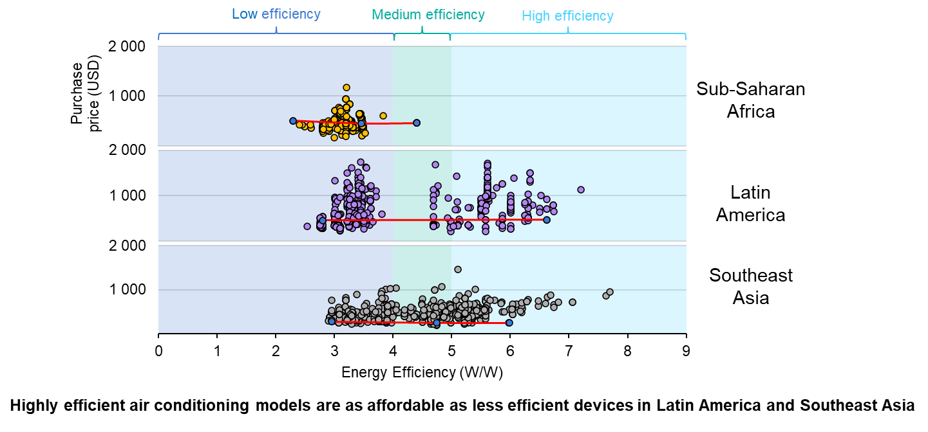
Increased efficiency does not necessarily mean higher costs
Air conditioners (wall-mounted type) efficiency and cost in Latin America, Southeast Asia, and sub-Saharan Africa, 2023.
Notes:
Affordability remains a key challenge in emerging and developing economies, and there is often a perception that more efficient air conditioners are more expensive. This misconception can often lead to governments holding back on the implementation of stricter MEPS.
Through our recent analysis we are finding that increased efficiency does not necessarily mean higher costs for consumers.
For example, as you can see here - in Southeast Asia the purchase price of a low efficiency air conditioner could be the same as for one that is twice as efficient - that would half the energy bill.
Here we also see the effects of MEPS overtime. Southeast Asia was the first of these regions to start international collaboration on setting MEPS. It now has the greatest range of efficiencies and the narrowest range of prices.
Latin America is the next market to develop rapidly and has a similar range of efficiencies but a wider range of prices which we expect to narrow over time as competition increases and the transparency of these processes improves.
Our next challenge is to drive the same outcome in sub-Saharan Africa which, as you can see, has much more limited consumer choice.
So how do we drive this market transformation?

Slide 7
Notes:
Thank you

