Slide 3
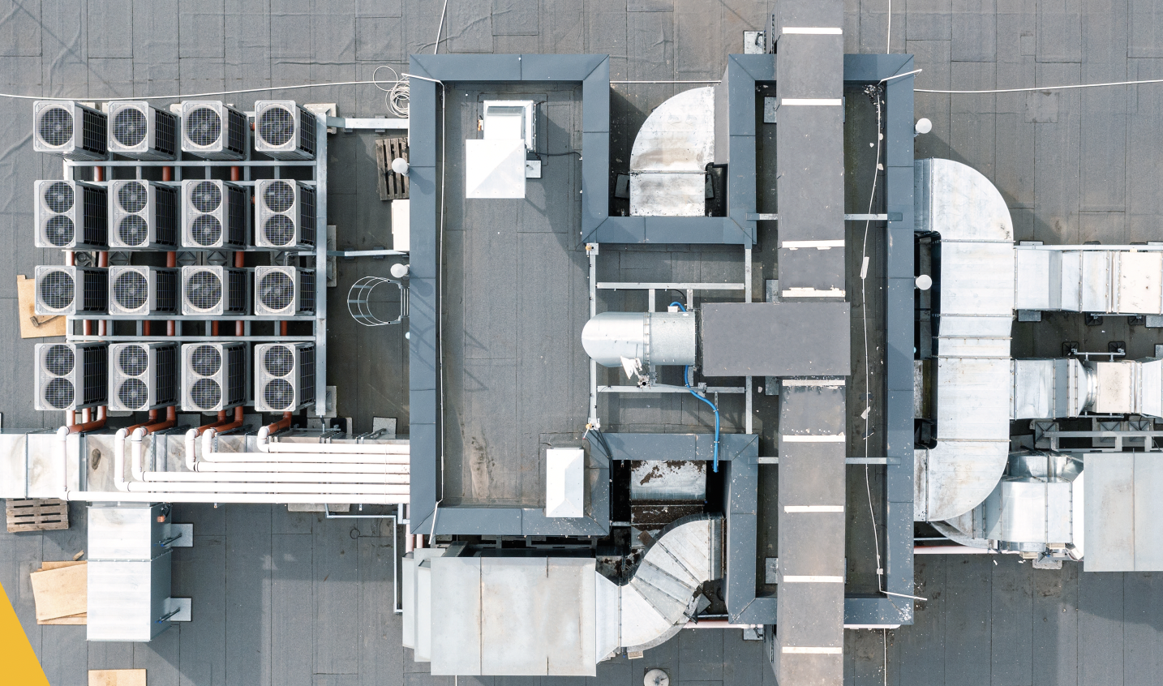
India Cooling Action Plan
Lessons so far, and the way forward
Chandra Bhushan
CEO & President, iFOREST
December 9, 2023

Slide 4
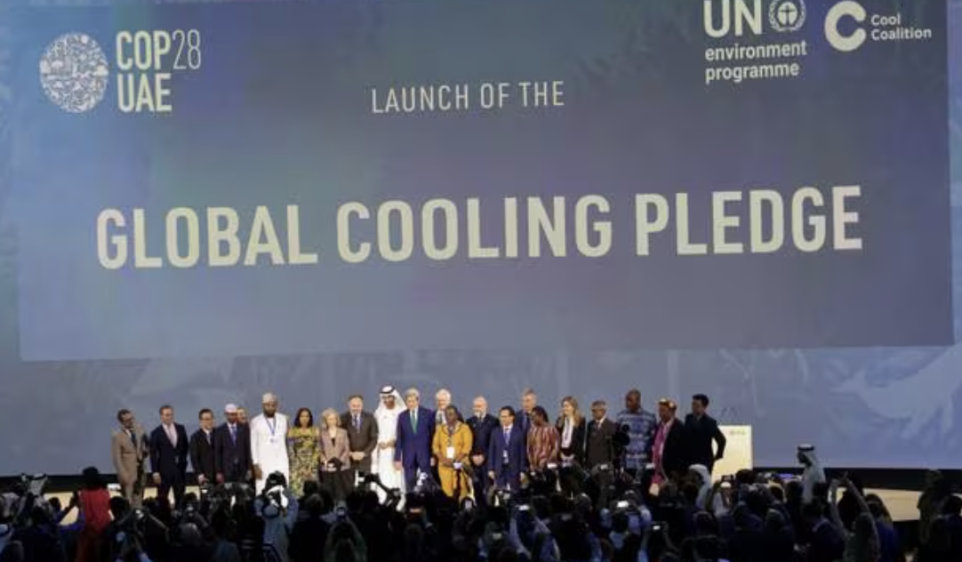
COOLING ON COP28 AGENDA
COP28 pledge to curb cooling emissions backed by 63 countries.
Countries commit to reduce their cooling-related emissions by at least 68% by 2050 compared to 2022 levels, along with a suite of other targets including establishing minimum energy performance standards by 2030.

Slide 5
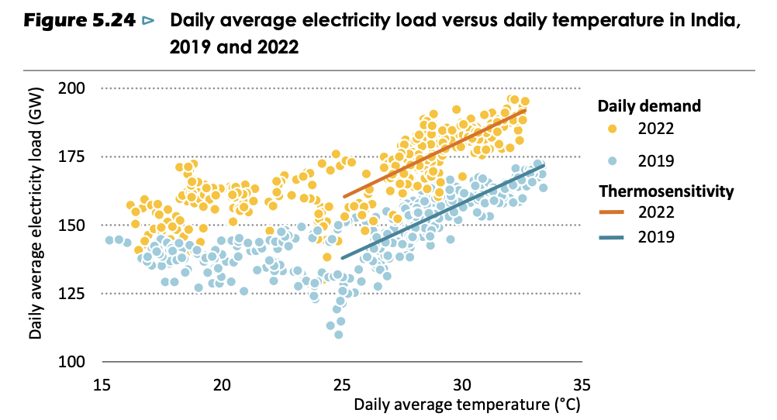
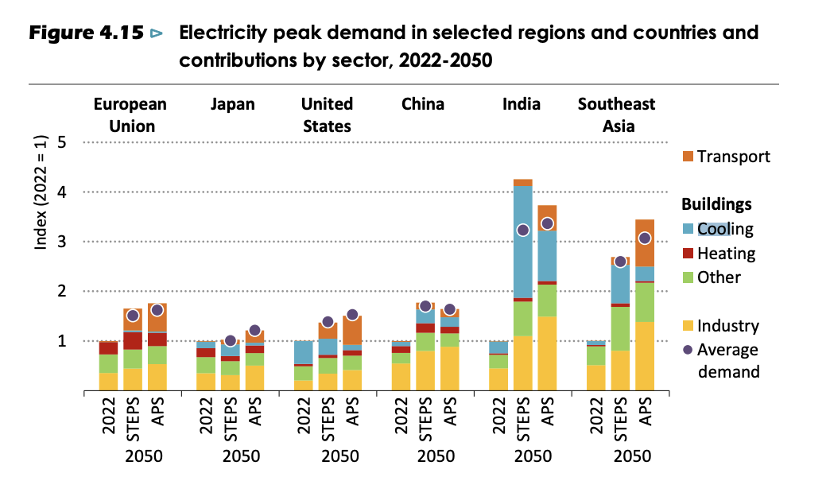
India Cooling Action Plan – Requirement
Daily average electricity load against daily temperature
Increasing incidences of heatwaves and rising humidity – Access to Cooling an Equity Issue
Ownership of ACs tripled since 2010 to reach 24 units per 100 households.
Space cooling now accounts for 10% of the total electricity demand (21% higher than its 2019 share).
By 2050, the household AC ownership is projected to increase nine-fold, leading to a nine-fold increase in cooling demand – maximum among major countries.
Electricity peak demand projections
Source: World Energy Outlook 2023

Slide 6
Reduce cooling demand across sectors by 20-25% by 2037-38.
Reduce cooling energy requirements by 25-40% by 2037-38.
Reduce refrigerant demand by 25-30% by 2037-38.
Recognise cooling and related areas as a thrust area of research.
Train and certify 100,000 servicing sector technicians by 2022-23.
ICAP Targets

Slide 7
Lessons from ICAP, & the way forward
Short-term target vs. Long-term Goal
Long-term goal important, but breakdown actions into clear, measurable and short-term targets (3-5 years)
Link synergies across different sectors – green building, DSM, appliances, energy price, DRE, smart-grid, refrigerant, carbon finance, technology transition, public procurement.
Leverage existing policies and programmes.
Synergy is the key word
Cooling action plan at a local-level (state and municipality).
Integrate sustainable cooling under green building efforts at the municipal-level.
Optimise cooling demand under demand side management.
Leverage existing environmental legislations for installation, use and maintenance of cooling equipment.
Localisation is crucial

Slide 8
Lessons from ICAP, & the way forward (cont..)
Natural Refrigerant standards in India -- Adoption of IEC 60335-2-40, ISO 5149-1:2014 & Ammonia for cold chains.
77% RAC can be converted to natural refrigerant with the existing technology = emission saving of 50 MTCO₂/year between 2025 and 2030.
Important for leapfrogging the ’Chemical Treadmill’ and IPR stranglehold of few companies.
Refrigerant transition
Clubbing national and international finance
National: incentives for EE, Green buildings, DSM, public procurement etc.
International:
Multilateral Fund on the Montreal Protocol – Refrigerant transition
Carbon market – Energy Efficiency
Other bilateral and multilateral
Pooling together finance

Slide 9
Lessons from ICAP, & the way forward (cont..)
Alternative to vapor compression essential to reduce energy demand
Need for dedicated funding under Montreal
R&D and demonstration.
NIK technology
All new generation refrigerants have higher risk
Reskilling for newer refrigerant and new technologies
Skilling and Reskilling

