Slide 1
A Just Transition of Thermal Power Plants
Chandra Bhushan | October 12, 2022

Slide 2
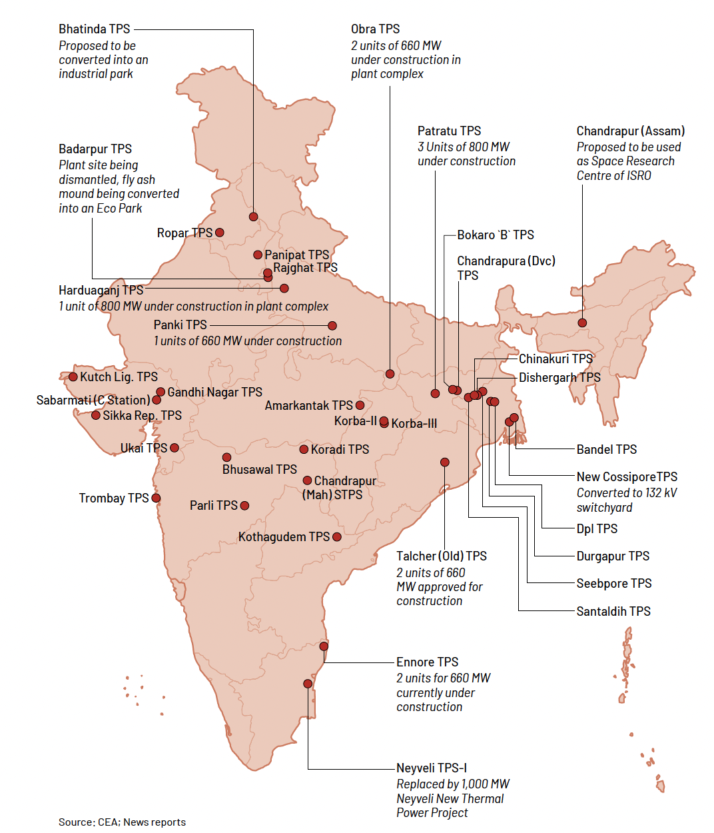
126 units 11.9 GW decommissioned in India during March 2016-June 2021 due to techno-economic & commercial considerations
2.7 GW being replaced by new units
1.4 GW being repurposed for non-energy
7.8 GW await further decision/ action
Visible shift in the approach of replacing old units with new, more efficient units
This trend to intensify in the future as competition from clean energy increases.
A new approach for managing coal closures is essential for India.

Slide 3
One-fifth of India’s coal capacity primed for decommissioning
9% capacity is 21-30 years old; 11% is 31-40 years; 2% is 41-57 years.
Assuming a retirement age of 25 years: > 51 GW to retire by 2030.
Note: Assuming an aggressive coal-phase down scenario, where units are retired after 25 years of operations; Source: CEA; Global Energy Monitor

Slide 4
Implications - Land
Coal-based power plants occupy an estimated land area of 1259 km² ~ size of NCT of Delhi.
Under a 25-year retirement scenario, about 200 km² will be available in next 10 years.
Source: iFOREST Estimates
Ownership represents a mix of freehold & leasehold land, and high share of government-owned land (2/3rd) – creating peculiar redevelopment challenges (risk of delayed/inefficient action in case of leasehold land, and risk of inaction in case of freehold land).

Slide 5
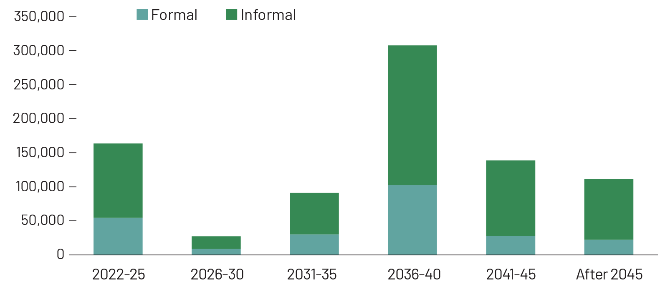
Implications - Labour
850,000 to 970,000 workers are estimated to be employed in the coal-based power sector.
70% of the workforce is informal labour, remaining 30% is a mix of departmental and contractual formal workforce.
Under a 25-year retirement scenario, 2 lakhs workers will be affected by 2030.
Estimated number of workers to be AFFECTED due to
power plant closures
At all decommissioned plant sites, informal and contractual labour compensation and reemployment is a major issue.
Source: iFOREST Estimates

Slide 6
Implications - Financial resources
Cost of demolition and scrap removal, cost of tendering | Fly ash pond management (stabilization or sale) | Compensation to all worker categories | Plant overheads (electricity, rent, security, insurance, taxes etc.)
Cost of clean-up – C&D waste, hazardous waste management | Cost of site decontamination & remediation | Cost of just transition initiatives (additional social security support) | O&M support to housing colony and other social infrastructure
Direct & indirect costs of TPP decommissioning
Rs 1,100 billion (at current prices) required for decommissioning of coal power plants (excluding the workforce and community JT costs)
Under a 25-year retirement scenario, 25,000 crores required by 2030.
ESTIMATED FUNDING REQUIREMENT FOR DECOMMISSIONING OF COAL-BASED POWER PLANTS IN INDIA
Clearly earmarked funds and established liabilities important to ensure decommissioning action
Source: iFOREST estimates

Slide 7
Implications - Environment
Power plant dismantling involves dealing with a number of hazardous wastes and toxic materials, including Asbestos, PCBs, heavy metals like mercury, and other hazardous waste.
Plant site requires remediation including managing accumulated fly ash and closure of ash ponds -- most challenging and expensive stage of decommissioning.
Remediation vital to ensure that the plant site is free of pollutants and contaminants and that the site is restored for the subsequent planned use.
What kind of regulatory framework would enable smooth decommissioning and remediation? How do we build expertise to undertake large-scale remediation and repurposing?

Slide 8
Thank You
chandra@iforest.global

