Slide 1
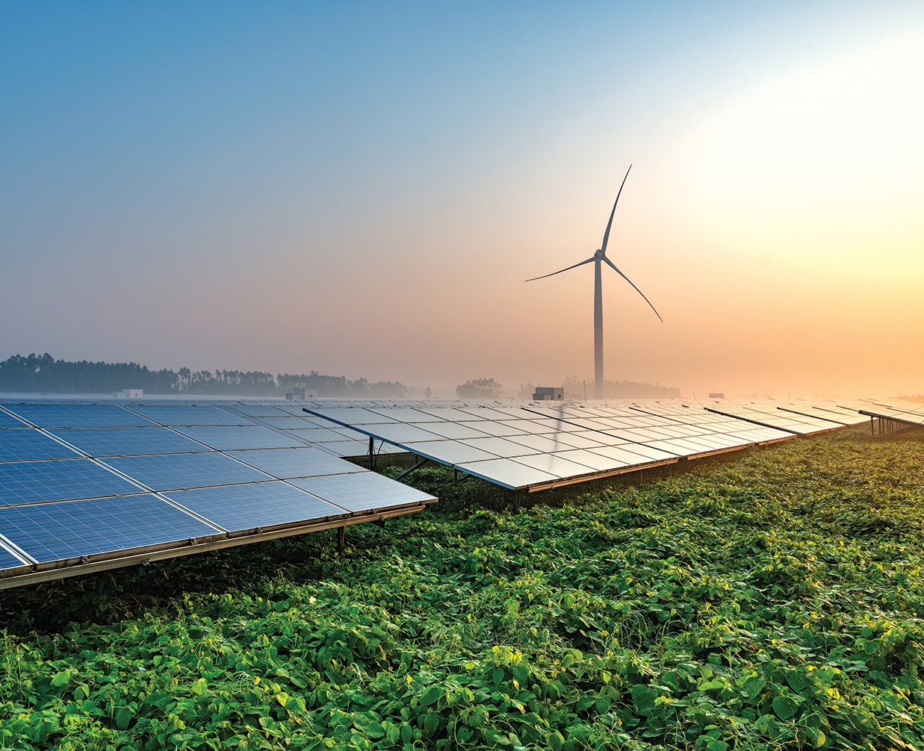
Renewable Energy Potential of Odisha
Chandra Bhushan
CEO & President, iFOREST

Slide 2
RE potential Re-assessment
MNRE vs. iFOREST assessed RE potential of Odisha
 | MNRE (MW) | iFOREST (MW)
Solar | 25,780 | 156,000
Biomass | 246 | 3,400
Wind | 8346 (120m) | 86 high-potential site identified with an average CUF of 22%-29% at 150 m hub height across 16 districts. Need detailed ground-level assessment

Slide 3
Impacts of OREP, 2022
The OREP, 2022 aims to decarbonize the energy sector by harnessing the state’s RE potential
RE capacity requirement for meeting new RPO of 43.33% by 2029-30
Source | Utility | Captive | Total
Wind | 900 | 2,600 | 3,500
Hydro | 300 | 900 | 1,200
Other | 4,500 | 12,500 | 17,000
Total | 5,700 | 16,000 | 21,700

Slide 4
Impact of implementing the OREP, 2022 by 2029-30
CO₂ emission reduction of 32% and PM, NOx & SOx emission reduction of 29% from utility consumption.
Minimal utility tariff increase of 2-3% relative to baseline trend.
Creation of 478,890 solar jobs and 4,445 wind jobs for meeting utility and captive requirements.
Minimal land requirement - 1.8% of the total wasteland area or 8.3% of the total reservoir area needed for setting up 17 GW solar capacity to meet the ‘Other RPO’
Projected utility tariff trend due to increased RE procurement aligned with new RPO

