Slide 1
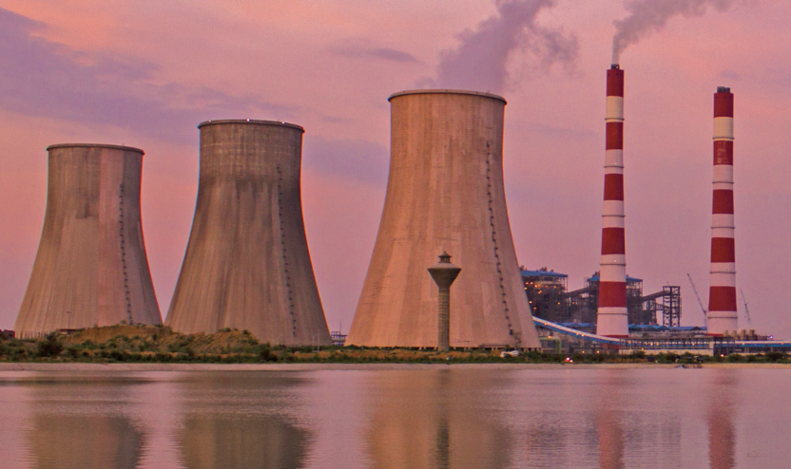

Decommissioning TPPs in India
Environmental, social and financial aspects
September 21, 2023
Inaugural Session

Slide 2
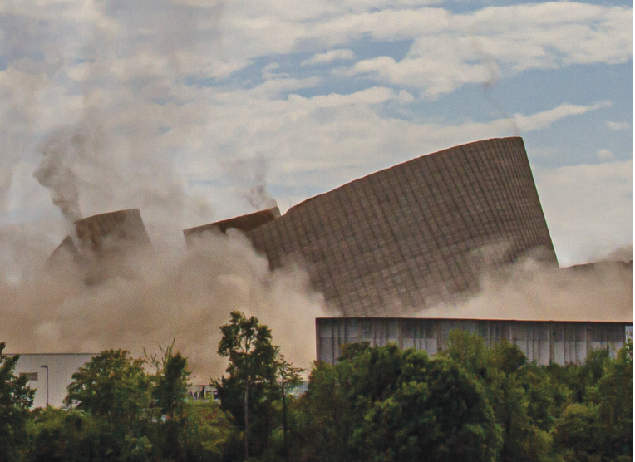
What is TPP decommissioning?

Slide 3

End of life activities at a power plant/unit
Retirement
Decommissioning
Redevelopment or repurposing
Removing equipment & materials from plant/unit site
Dismantling infrastructure (as required)
Environmental remediation of plant site, especially ash pond
Management of social impact (workers & community)
Hazardous & other waste management – handling and removal

Slide 4
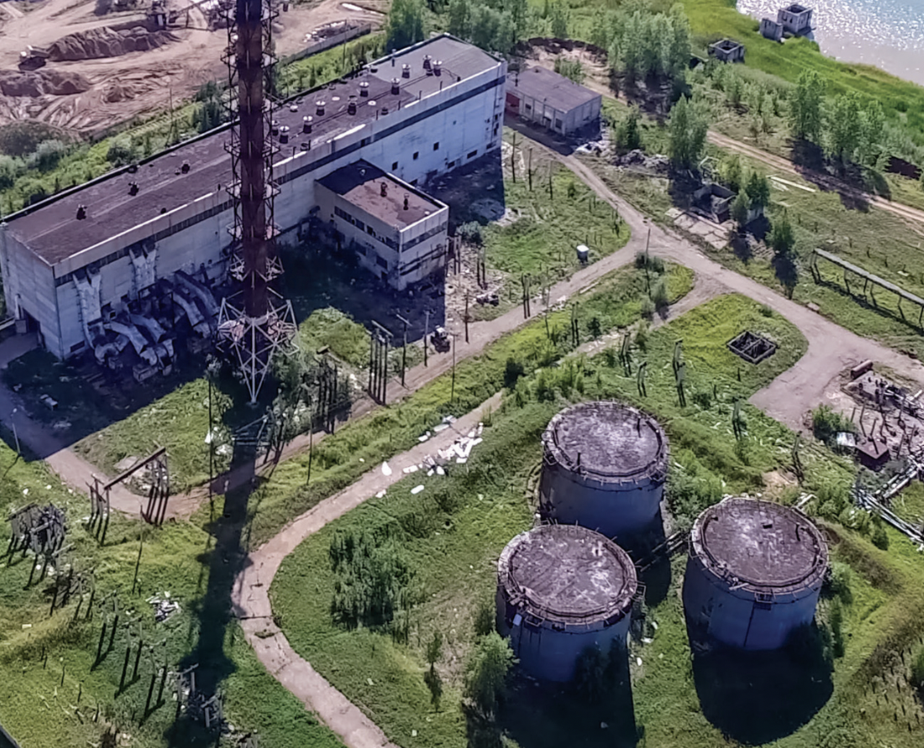
Why is regulatory guidance important for planning and executing thermal plant/unit decommissioning projects?

Slide 5
Substantial number of decommissioning projects are currently ongoing, and planned for future
Over the past decade, 18.4 GW of thermal capacity across 260 units has been retired from operations.
Limited number of retired units being replaced by new thermal capacity – 2.7 GW out of 12 GW retired since 2016.
Over the medium term, additional 2.1 GW is planned for retirement till 2032 (as per the CEA generation plan).
However, it will pick up pace over longer-term, as energy security is ensured through alternate sources, as over 1/5th of installed thermal capacity has already primed for decommissioning.

Slide 6
Decommissioning is a complex activity with multi-dimensional considerations
Environmental
Plant/unit dismantling involves dealing with hazardous wastes, toxic materials, construction and demolition waste.
Plant sites also require environmental remediation, especially to reclaim ash ponds.
Social
Power plants provide substantial employment – 2 formal and 2.5 informal workers per MW.
Informal and contractual labour compensation and reemployment major issue during decommissioning. Existing social security net inadequate in this context.
Financial
Direct and indirect costs involved in decommissioning, estimated to be $50,000 to $150,000 per MW.
Existing tariff mechanism doesn’t account for recovery of decommissioning costs.
Repurposing or reuse
Coal-based TPPs occupy substantial land area - 1259 km² in aggregate.
No efficient mechanism in place to decide on next best use, made complicated by ownership patterns.

Slide 7
Need for adequate guidance on decommissioning being steadily recognized by legal/regulatory bodies
NGT (Southern Bench) orders for developing guidelines for TPP decommissioning as part of proceedings in case of Dharmesh Shah vs Union of India & Others.
CERC issues ‘Approach Paper on Terms & Conditions of Tariff Regulations 2024-29’ acknowledging decommissioning costs for the first time.
Feb 2021
July 2021
May 2023
Jun 2023
CPCB issues ‘Environmental Guidelines for Decommissioning a Coal/Lignite-Fired Power Plant (Draft)’ in consultation with CEA and MoEF&CC
CEA and CPCB issue ‘Guidelines on Design, Construction, O&M and Annual Certification of Coal Ash Ponds’ addressing issues of stabilization and reclamation

Slide 8
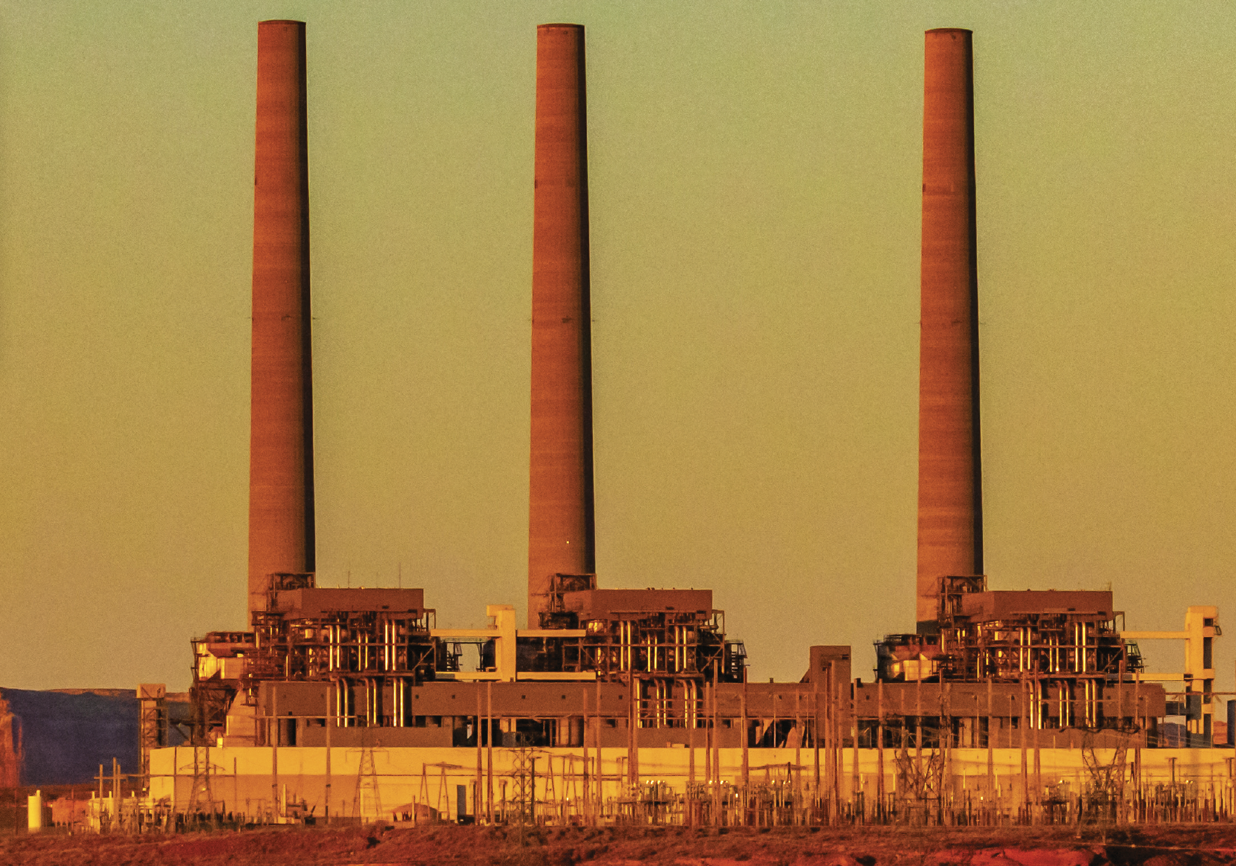
The way forward…

Slide 9
Environmental aspects
Environmental Guidelines for Decommissioning a Coal/Lignite-Fired Power Plant (Draft) comprehensively list relevant acts, rules and notifications, as well as introduce procedures to be followed for planning and executing decommissioning.
Guidelines on Design, Construction, O&M and Annual Certification of Ash Pond establish the regulatory requirements for stabilization, reclamation and certification of abandoned ash ponds (crucial for an environmentally sound decommissioning).
However, significant scope for strengthening the existing guidelines to ensure effectiveness, through introduction of time-bound mandate, as well as introduction of procedures to ease decommissioning and incentivises repurposing, simplify consents and clearances etc.
A strong case for giving solid legal basis for decommissioning TPPs.

Slide 10
Financial aspects – Understanding decommissioning costs
Pre-demolition phase
Demolition phase
Post-demolition phase
O&M costs - continued employee costs & station overheads
Cost worker compensation
Cost of planning for closure - ESIA studies & technical evaluations
Cost of securing statutory clearances & permits
Cost of tendering works
Cost of identification, removal & transport of salvageable material
Cost of plant demolition works
Costs of separation, recycling, and disposal of demolition materials
Cost of site clean-up
Monitoring and management costs
Environmental remediation due to groundwater/soil contamination
Contingency costs due to unplanned environmental damages
Cost of monitoring/manning the site, till its repurposed.
Decommissioning costs can range from $50,000 to $150,000, depending on factors such as plant size, the environmental damage, decided site end use and recovered salvage value.
In India, existing tariff provisions pertaining to recovery of salvage value, impairment loss of asset value, and change in law, are inadequate.
If decommissioning is not made financially viable, generation companies are likely to abandon their plants in an ‘as-it-is’ state due to lack of funds.

Slide 11
Mechanisms for recovering decommissioning costs
Multiple examples exist nationally and globally of mechanisms for recovering cost of decommissioning energy assets. Typically, the recovery mechanisms allow for the accrual of funds over a long period of time, prior to the planned decommissioning.
Mechanism to support coal mine closure
‘Guidelines for Preparation of Mining Plan for the Coal and Lignite Blocks’ Ministry of Coal issued December 2019
Mine owners required to open a fixed escrow account in any scheduled bank, with COO as exclusive beneficiary, prior to commencement of mining activities.
Fund to be submitted – Rs 900,000/hectare for opencast & Rs150,000/hectare for underground mines (2019 price)
Final review of funds and closure plans undertaken five year prior to date of closure – fund gap covered by the mine owner.
Funds for progressive and final closure.
Mechanism to support nuclear power plant closure
AERB’s safety manual AERB/SM/DECOM-1 in March 1998
Decommissioning levy collected as part of generation tariff and collected in a ‘Decommissioning Fund’ held and managed by NPCIL on behalf of the DAE.
Levy currently stands at 2 paise per unit.
Use of public and private funds, particularly to support any early closure scenario

Slide 12
CERC’s approach paper for new tariff regulations for 2024-2029
Acknowledges the decommissioning costs for generation as well as transmission assets.
“appropriate provisions in the tariff regulations to deal with all eventualities”
‘to reduce risk perception among investors and provide the necessary clarity on such matters thus reducing litigations.’
Suggests – net profit/net loss post decommissioning and disposal of assets may be adjusted in one go from the beneficiaries, duly factoring unrecovered depreciation.
Challenge – inadequate to protect owners from liability default

Slide 13
Recommendations for cost recovery
Accrual of decommissioning costs over a long period
Scenario-based mechanism based on vintage of the power plant
Allowing recovery of decommissioning costs through a tariff component, to be held as a state level fund to support unit-level as well as plant level decommissioning
Scenario 1
Plants with at least
5 years life
Scenario 2
Plants with less than
5 years life
Scenario 3
Plants closing prematurely
A decommissioning tariff component introduced as part of the tariff. The amount put in a ‘state decommissioning fund’ and reimbursed to plants based on decommissioning progress.
One time settlement between plants and the discoms. Money deposited in ‘state decommissioning fund’ and reimbursed to plants based on decommissioning progress.
1. Private deal by plant owbers to recover outstanding liabilities and decommissioning costs.
2. Corpus fund to support premature
decommissioning.

Slide 14
Thanks.

