Slide 1
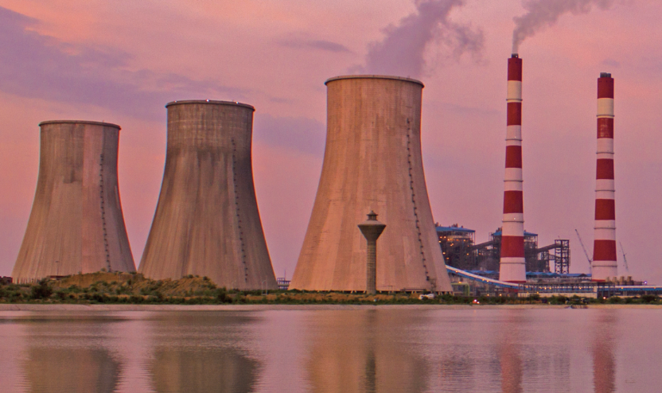
Decommissioning TPPs in India
Environmental, social and financial aspects
September 21, 2023
Environmental Considerations in Decommissioning Retired Thermal Power Plants
Session 2

Slide 2
Environment – A key consideration in a TPP decommissioning project
Handling and clean-up the hazardous materials utilized, generated and stored during power generation (such as ACM, PCBs, toxic metals, mercury etc.)
Managing e-waste, and re-useable chemicals and equipment
Managing water & air pollution during dismantling
Handling and managing construction and demolition waste
Stabilization and reclamation of ash pond
Overall clean-up and environmental remediation

Slide 3
Order of Hon’ble National Green Tribunal (South Bench)
Order dated March 23rd 2021 in the matter Dharmesh Shah Versus Union of India and Others concerning decommissioning Neyveli Thermal Power Station-I in Tamil Nadu.
“there is no general guideline or monitoring system to supervise the decommissioning process of TPPs”
“…the questions need to be addressed in a scientific manner…”
“MoEFCC, CEA and CPCB to constitute a joint committee of their own and evolve a policy or guideline as to how the decommissioning of thermal power plant unit has to be carried out… including manner of creating mechanism to supervise as to how it is being properly implemented by the power plant and mining area”

Slide 4
Environmental Guidelines for Decommissioning a Coal/Lignite-Fired Power Plant (Draft), July 2021
Determine future land use
Undertake Environmental Impact Assessment
Prepare Environmental Management Plan
Secure approvals, clearances & consents
Set up team for project execution
Execute dismantling and clean up
Periodic regulatory inspections
In planning and executing a TPP decommissioning project, plant owners must ensure compliance with all relevant environmental and occupational safety statutes, rules and guidelines issues by central, state and local authorities.

Slide 5
Relevant Acts, Rules and Notifications
Water (Prevention & Control of Pollution) Act, 1974
Air (Prevention and Control of Pollution) Act in 1981
Hazardous and Other Wastes (Management and Transboundary Movement) Rules, 2016
Construction and Demolition Waste Management Rules, 2016
MoEFCC notifications for fly ash utilization and ash ponds
In June 2023, CEA and CPCB issued ‘Guidelines on Design, Construction, O&M and Annual Certification of Ash Ponds.’
In context of plant decommissioning, the following provisions of become relevant:
Statutory permission from relevant regulatory authorities required for abandoning an ash pond.
All measure need to be adopted to prevent pollution from abandoned pond.
Reclamation of ash disposal facility is to be endured, through complete dewatering, site preparation, and placement of earth cover (300 mm).
Area can be vegetated or used for solar or wind power plant installation (following feasibility study, statuary clearances and adequate measures to prevent surface erosion and pollution).
Annual certification of reclaimed ash pond and dykes is to be ensure by plant owners and the report submitted.

Slide 6
Strengthening Environmental Guidance
Provide clear timelines for action
Undertake an environment assessment of retired power plant (instead of a detailed EIA study)
Provide clear guidance on developing EMP for decommissioning
Ensure that social and community concerns are addressed in the EMP
Provide for a unified consent and a single window clearance mechanism
Provide guidance on engaging specialized agencies for decommissioning
Ensure a stringent monitoring mechanism
Introduce a mechanism for final audit and certification
Build an incentive for repurposing

Slide 7
Thanks.

