Slide 1
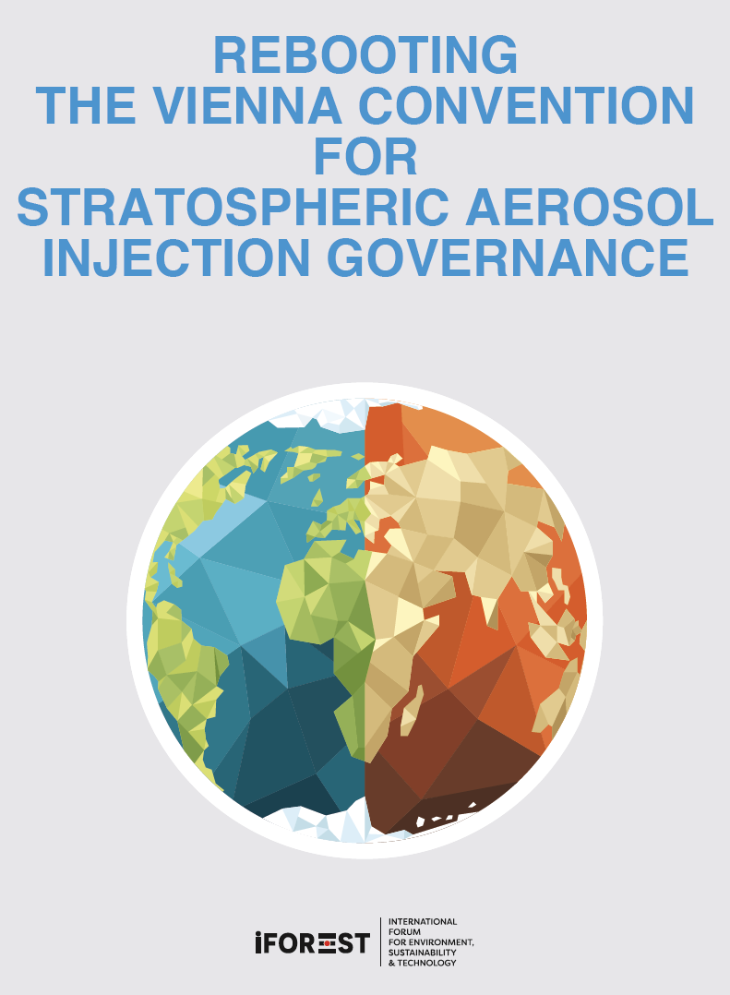
Side Event 35th Meeting of the Parties to the Montreal Protocol on Substances that Deplete the Ozone Layer Tuesday, 24th October 2023 United Nations Office at Nairobi
Chandra Bhushan
CEO & President, iFOREST

Slide 2
Evolution of SAI
Impractical technology confined to the labs

Slide 3
Evolution of SAI
“Emergency” solution to counteract drastic temperature rises in the future.

Slide 4
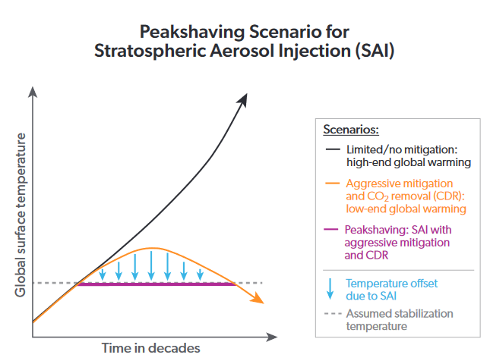
Evolution of SAI
Partial or complete substitute to the mitigation of GHG emissions -- use alongside other GHG mitigation strategies within a decade.
Source: WMO Scientific Assessment of Ozone Depletion 2022

Slide 5
Critical issues with SRM
Benefits – theorized, unproven, achievable by other means (mitigation, resilience & adaptation)
Magnitude of risk – poorly understood, likely high
Scope of risk – global, uneven, extending beyond national borders

Slide 6
Need for governance
Research concentrated in few countries; limited information sharing.
Quickly moving to outdoor experiments
Boundary between small-scale outdoor experiment, large-scale outdoor experiment and deployment unclear.
Boundary between climate adaptation and SRM deployment unclear.
Overlap between climate science experiments and SRM experiments.
Research governance needed as the scope of risk extends beyond national borders.

Slide 7
Current global governance on SRM
Convention on Biodiversity (1992)
2010 COP Decision bans geoengineering, with narrow exception for small-scale research “only if they are justified by the need to gather specific scientific data and are subject to a thorough prior assessment of the potential impacts on the environment”.
No framework for prior assessment and approval.
Wide participation, but U.S. not a party.
London Convention on Marine Pollution (1972)
2010 COP decision creates research assessment framework for ocean fertilization experiments
Ocean fertilization is a type of carbon dioxide removal geoengineering
87 parties, including US, several EU countries and China. India not a party.

Slide 8
Current global governance on SRM
London Protocol on Marine Pollution (1992)
2013 parties decision to regulate all ocean-based geoengineering
‘Negative list’ approach – all activity including experiments prohibited unless expressly assessed and permitted
53 parties, U.S. not a party.
Outer Space Treaty (1967)
No express governance, could govern space reflectors
114 parties, including all major spacefaring nations
No specific global governance on Stratospheric Aerosol Injection, the most advanced SRM technology.

Slide 9
SAI and Ozone layer modification
Scientific Assessment Panel, 2022
…. would “very likely cause unintended consequences, including changes in stratospheric ozone concentrations.”
“Stratospheric Aerosol Injection rates sufficient to achieve 0.5 °C of global cooling over the period 2020–2040 would result in a reduction of total column ozone close to the minimum values observed between 1990 and 2007.”
An independent expert review on Solar Radiation Modification research and deployment, UNEP, 2023
“Recent studies considering sulphate aerosols indicate that stratospheric ozone depletion would be increased in the polar stratosphere, the Antarctic ozone hole recovery could be delayed by a couple of decades and the ozone hole could become deeper in the first decade of SAI deployment”.

Slide 10
Ozone layer modification and Vienna Convention
Article 2.1 - has a wide scope and covers all human activities which “modify or are likely to modify the ozone layer”. This will include SAI as it will likely modify the Ozone layer.
Article 2.2 (a) - parties required to “co-operate by means of systematic observations, research and information exchange in order to better understand and assess the effects of human activities on the ozone layer and the effects on human health and the environment from modification of the ozone layer”. This will include SAI research and associated activities.
Article 2.2(c) - parties required to “co-operate in the formulation of agreed measures, procedures and standards”, which will extend to procedures and standards for SAI research.

Slide 11
Regulating SRM under the Vienna Convention: Key Provisions
Article 3 - parties commit to co-operate in, directly or through competent international bodies, the conduct of research and scientific assessments on “climatic effects deriving from any modifications of the ozone layer” and more specifically “substances, practices, processes and activities that may affect the ozone layer, and their cumulative effects”. This will include SAI.
Annex I - Major scientific issues requiring cooperation are:
Modification of the ozone layer which would result in a change in the amount of solar ultra-violet radiation having biological effects (UV-B) that reaches the Earth’s surface
Modification of the vertical distribution of ozone, which could change the temperature structure of the atmosphere and the potential consequences for weather and climate.
The word modification includes “deliberate modification”, such as through SAI outdoor experiment.

Slide 12
The Duty to Co-operate
Duty to co-operate:
Recognized principle of international law
Requires states to notify and consult other states even if they believe that no harm will result or are taking reasonable steps to avoid harm.
Complementary to the duty to avoid/prevent transboundary harm.
Undertaking SRM research activities without making the scope of and risks associated with the research clear to other states is clearly contrary to the duty to co-operate in Article 2.2(a) and Article 3 of the Convention.
The duty to cooperate made explicit under the Convention provides a strong basis to create a cooperative research framework to manage SAI and other ozone-depleting SRM research.

Slide 13
One integrated global regulatory framework/treaty or Regime Complex
Criticism of current governance, proposed solutions
Fragmented in multiple treaties – mix of gaps and overlaps, reducing clarity
Need a new integrated global regulatory framework and a new treaty (C2G)
Our view:
An integrated treaty is not feasible because different SRM technologies have emerged from different field, have different impact profile and requires distinct expertise.
A new treaty will exhaust limited time and political capital
Multiple treaties not a problem, can regulate distinct SRM technologies.

Slide 14
One integrated global regulatory framework/treaty or Regime Complex
Regime Complex – multiple treaties operating simultaneously within a particular issue area – has advantage over one treaty:
They are inherently flexible and adaptable.
They allow for experimentation and innovation within individual regimes - successful practices can be shared and adopted by others.
Regime complexes also tend toward specialization
They are also more inclusive, often involving a diverse set of actors.
The Montreal Protocol is itself a classic example of a flexible, inclusive and specialized treaty.

Slide 15
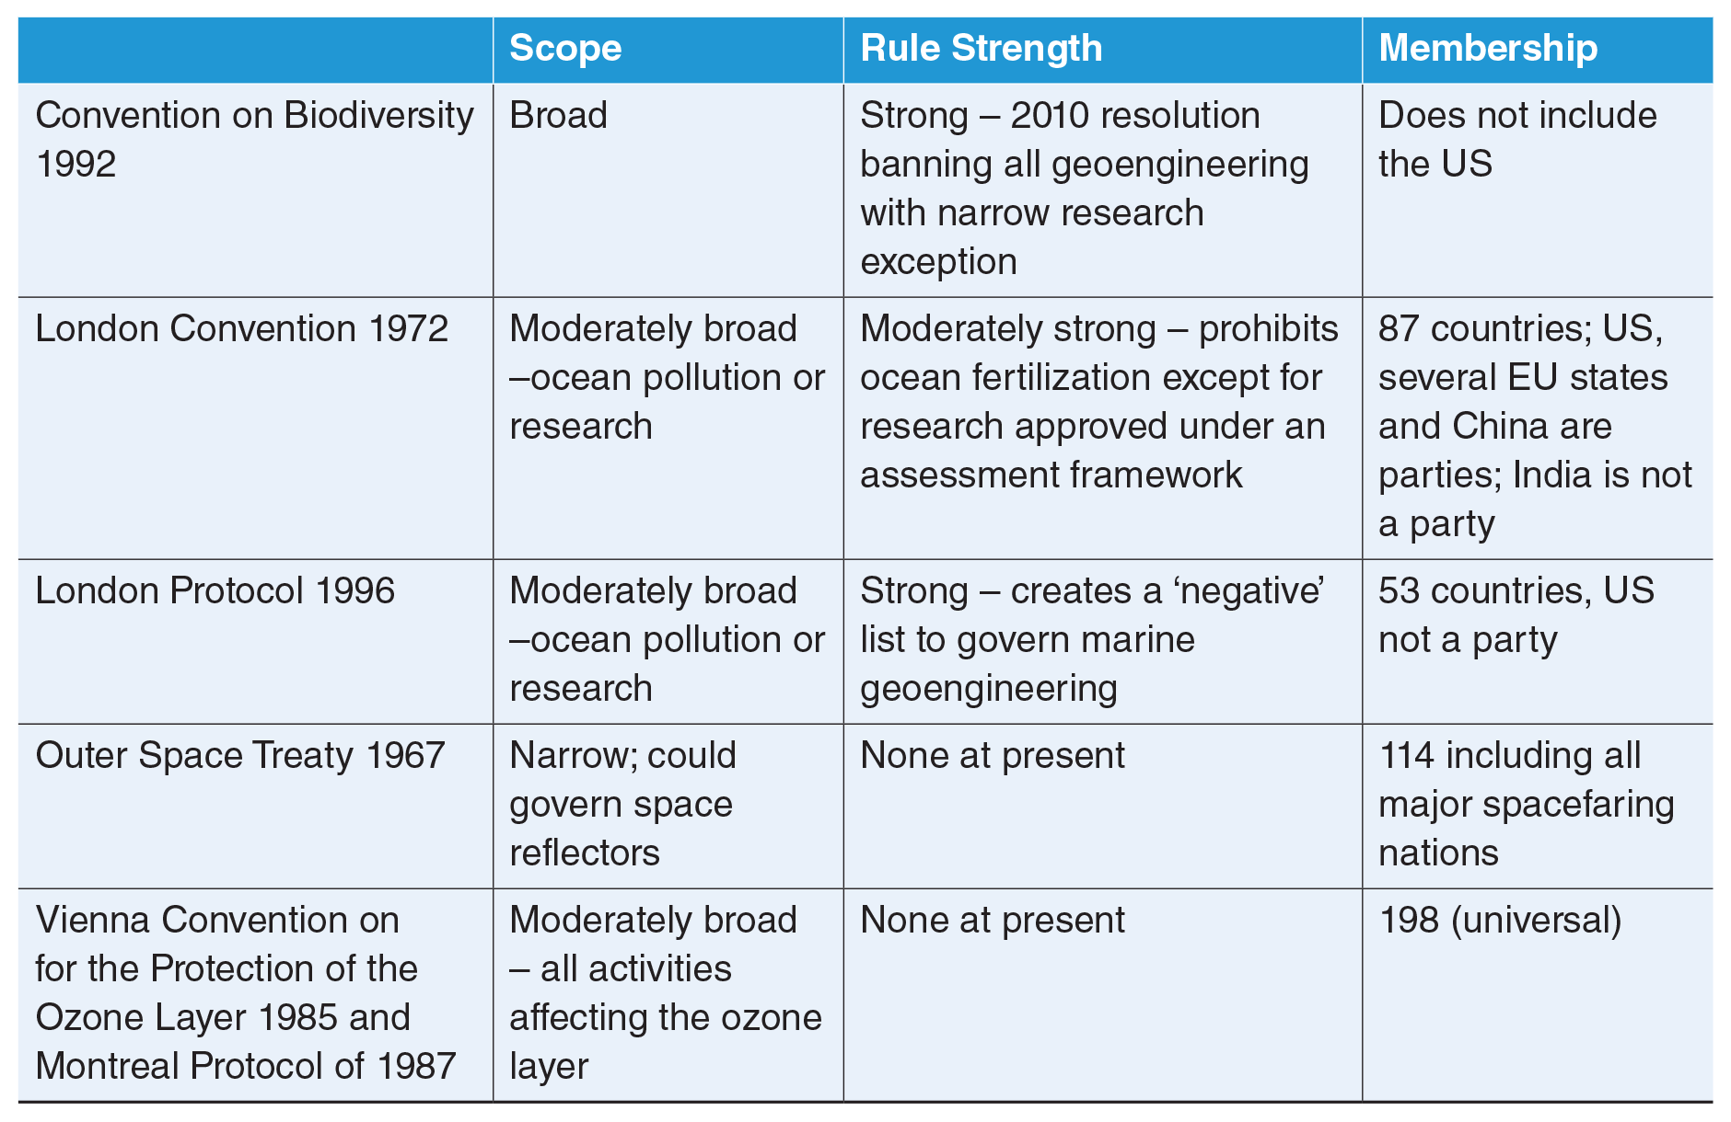
Regime Complex on SRM

Slide 16
Governance of SAI research under the Vienna Convention
Three categories of research – indoor, outdoor small-scale & outdoor large-scale.
Indoor research (model/simulation, lab-based studies) does not require regulation, but does require norms, guidelines and codes of conduct for research and sharing information.
No definition of small-scale and large-scale outdoor experiments
UNEP’s Independent Expert Review suggests that the distinction between small-scale and large-scale experiments should be based on “intent”. But intent is not an objective basis for governance.
Our proposal: All outdoor research should be governed by internationally agreed norms, guidelines, codes of conduct and best practices for research because:
Threshold between small and large-scale is currently unclear.
Even “small-scale” experiments can have transboundary impacts
Without governance, research on deployment feasibility is likely to be prioritized; research on adverse impacts will likely be left behind.

Slide 17
Research Assessment Framework under Vienna Convention
Information Sharing and Consultation
Structured Environmental Impact and Risk Assessment
Independent National Oversight
An International Approval Process

Slide 18
Information Sharing and Consultation
Core of the Vienna Convention
Can borrow from phrasing in other regimes, such as:
Outer Space Treaty – Experiments that “would cause potentially harmful interference with activities of other States” are subject to prior appropriate international consultation
London Protocol on Marine Pollution Research Assessment Framework for ocean-based geoengineering – “Where the [proposed activity] […] may have any effect in any area of the sea in which another State is entitled to exercise jurisdiction or in any area of the sea beyond the jurisdiction of any State, potentially affected countries and relevant regional intergovernmental agreements and arrangements should be identified and notified and a plan should be developed for ongoing consultations on the potential impacts, and to encourage scientific cooperation.”

Slide 19
Structured Environmental Impact and Risk Assessment
Based on similar requirement in the London Convention Research Assessment Framework for Ocean Fertilization
Elements of EIRA:
Problem Formulation
Site Selection and Description
Exposure Assessment
Effects Assessment
Risk Characterization
Risk Management

Slide 20
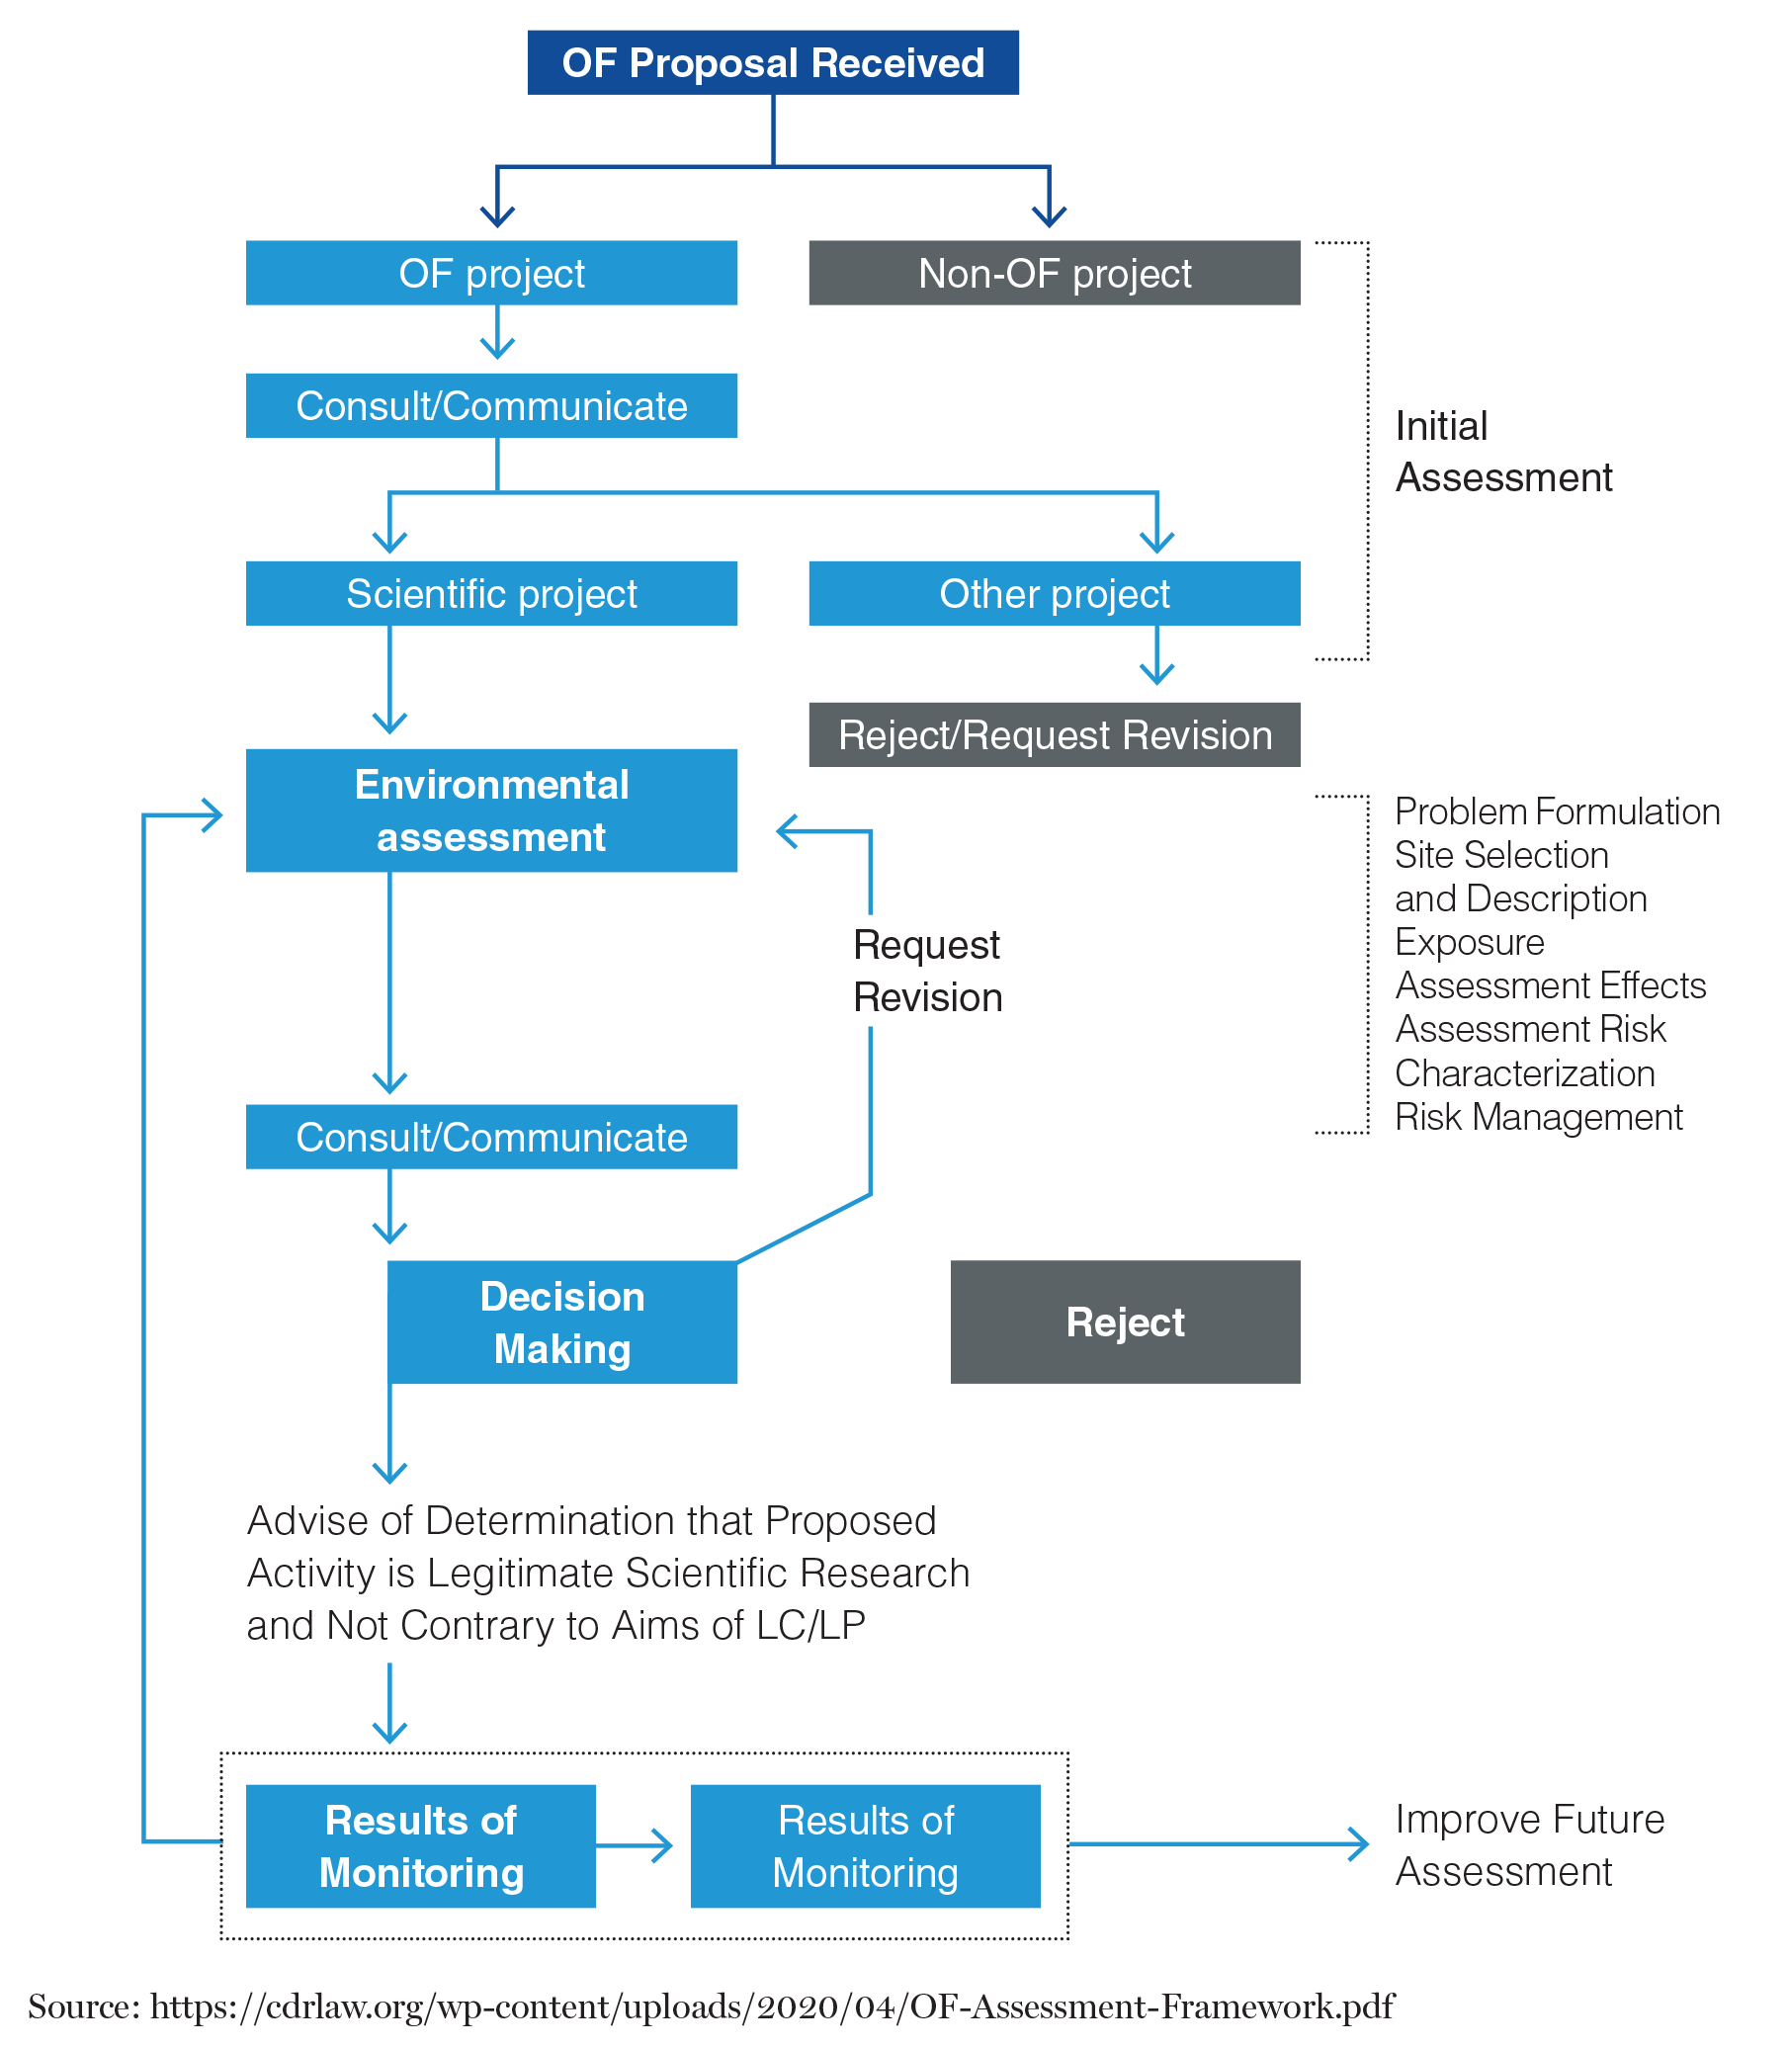
Research Assessment Framework for Ocean Fertilization under the London Convention

Slide 21
Independent national scientific oversight
Scientific oversight involves asking the following questions at the national level:
The rationale, research goals, scientific hypotheses and methods, scale, timings and locations of proposed experiments, with clear justification for why the expected outcomes cannot reasonably be achieved by other methods.
Whether there is any financial and/or economic gain arising directly from the experiment or its outcomes.
Whether the proposed experiments has or will go through scientific peer review with the review methodology and outcomes made publicly available.
Not enough independent national institutions to ask these questions –
Funding/supporting research and regulation of research are currently combined; they need to be separated.

Slide 22
International approval process

Slide 23
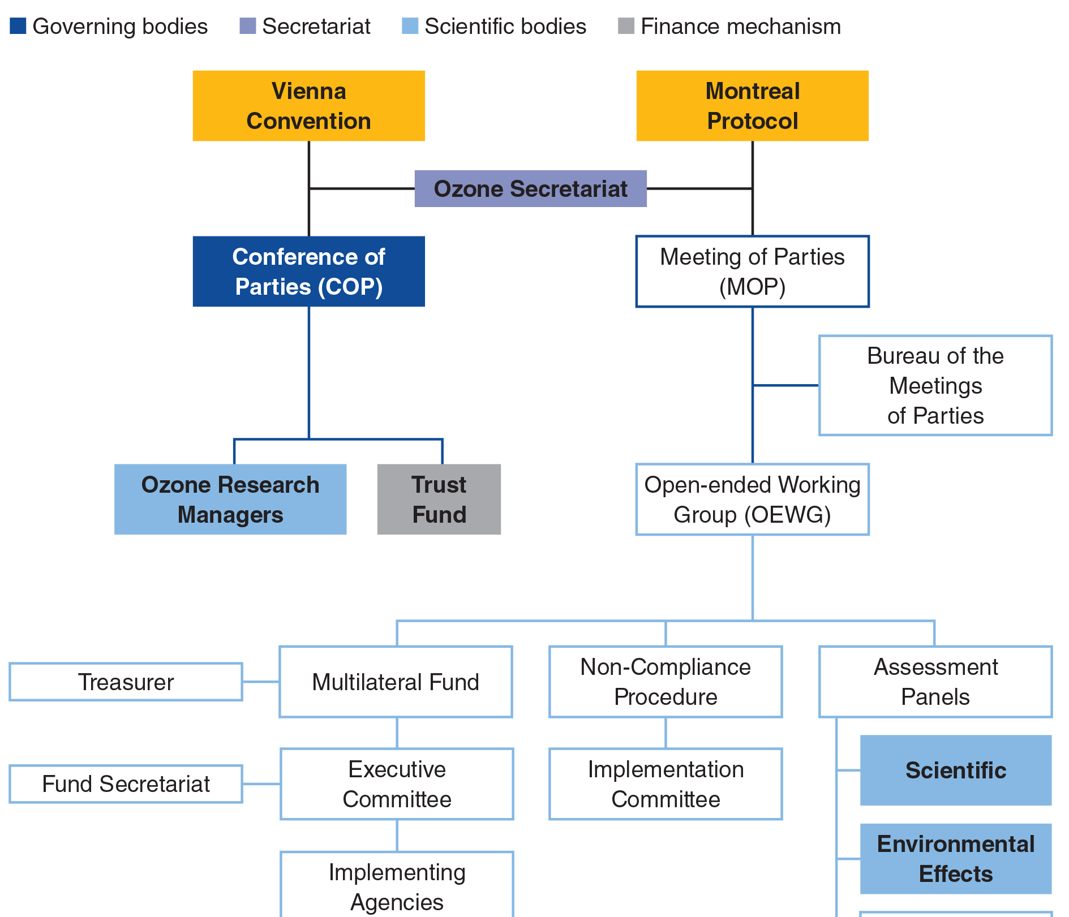
Rebooting the existing institutions under the Vienna Convention

Slide 24
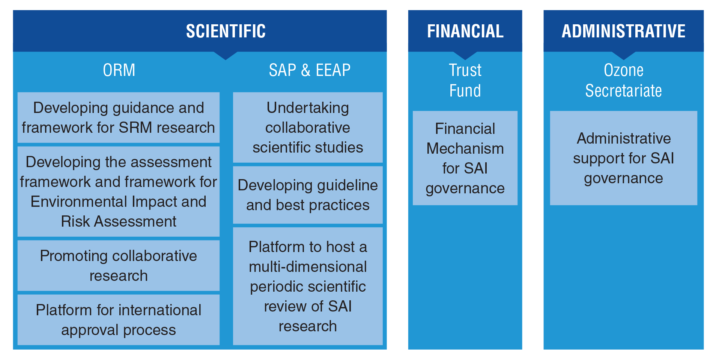
Rebooting the existing institutions under the Vienna Convention

Slide 25
Thank You !

Slide 26
Limitations in Using the Montreal Protocol to Regulate SAI
Regulating SAI under Montreal Protocol is difficult because:
Protocol is designed to phase down controlled substances to levels considered safe, rather than preventing introduction of a new substance.
“Controlled substance” emission during production and consumption – research activity is not technically production or consumption.
Difficult to set a defined ‘schedule’ for phasing down of research inputs – safe amount is unclear.
Vienna Convention has all the elements to govern SAI research.

